Slide 1
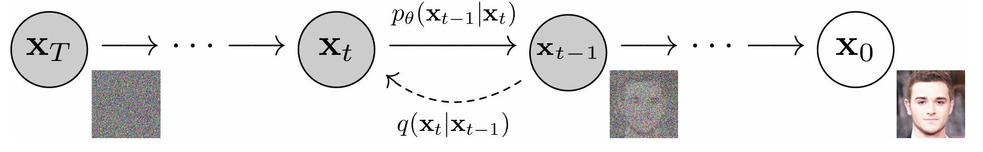
Deeper into Diffusion Probabilistic Models
Jinhao Zhang

Slide 2
Contents
DDPM(Dr. Ho, UCB, 2020)
Score Matching(Dr. Song, Stanford, 2019)
Langevin Dynamics Sampling
Noise Conditional Score Matching
SMLD & DDPM
Applications
SDE(Dr. Song, Stanford, 2020)
DPM-Solver(Dr. Lu, THU, 2022)

Slide 3
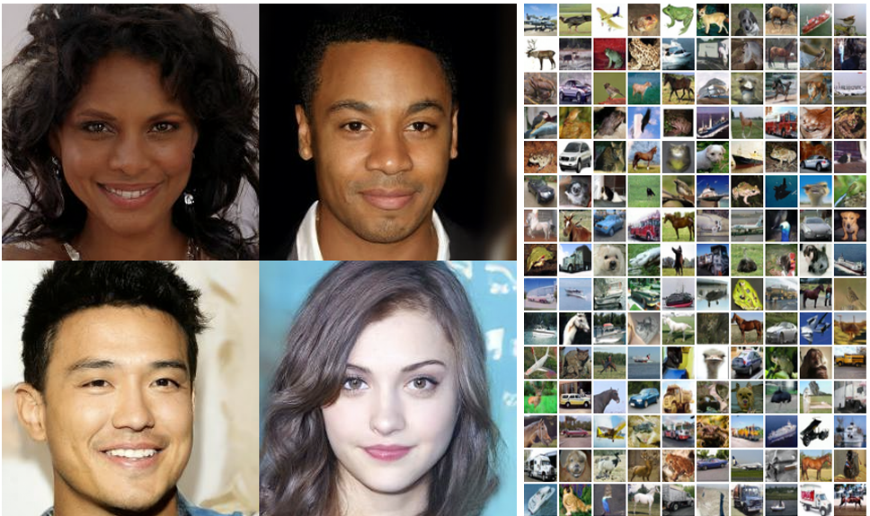
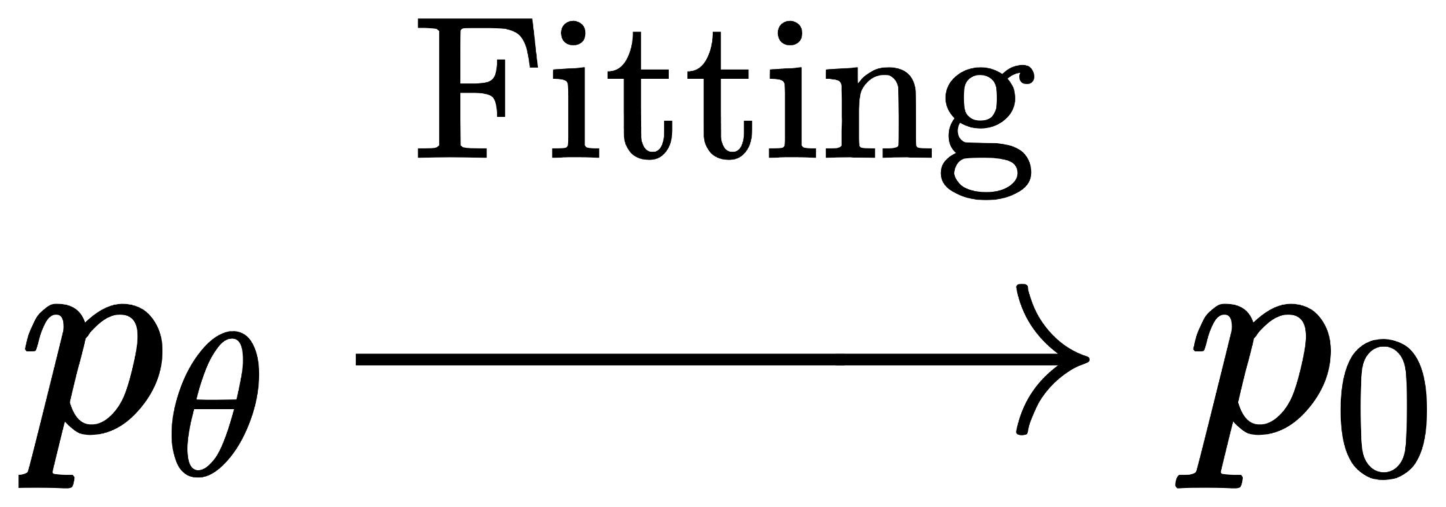

Generative Model
Function Fitter

Slide 4
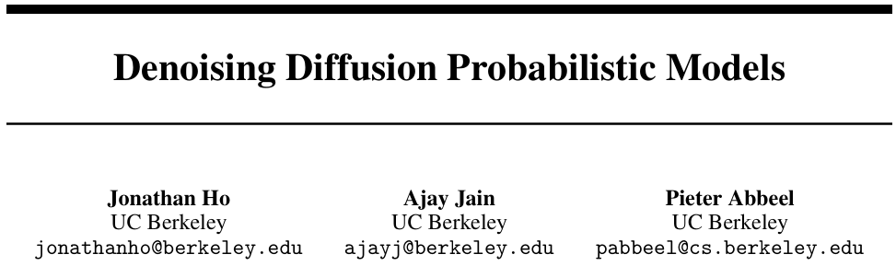
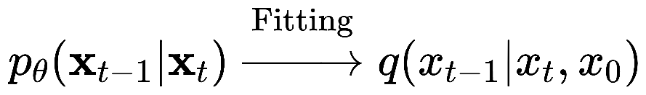
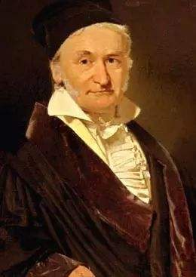
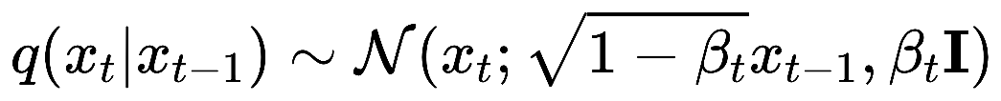
DDPM
Denoising
Max-entropy Distribution
Low-entropy Distribution
Diffusion

Slide 5
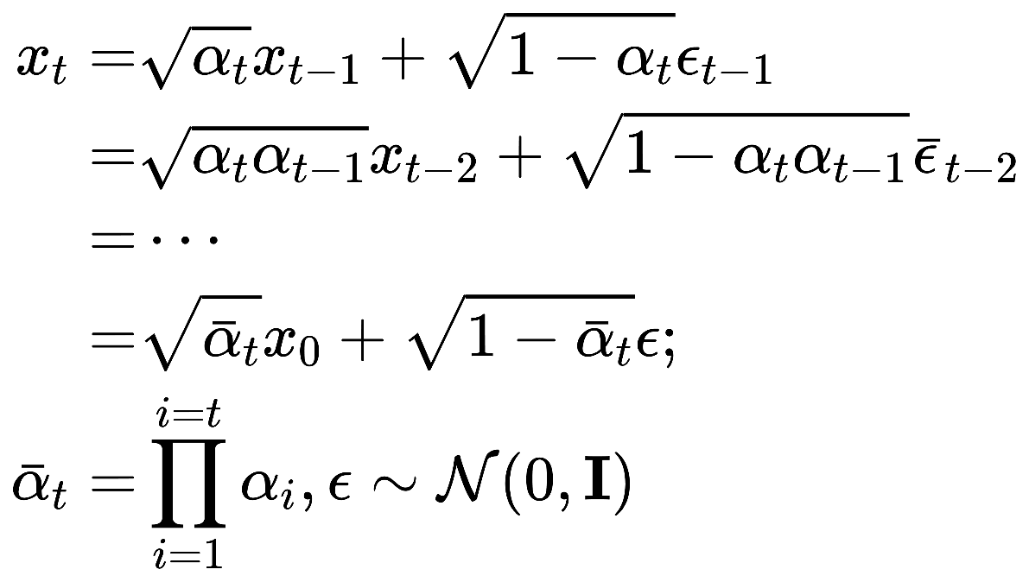
Diffusion Process
Markov property
Reparameterization
=>

Slide 6
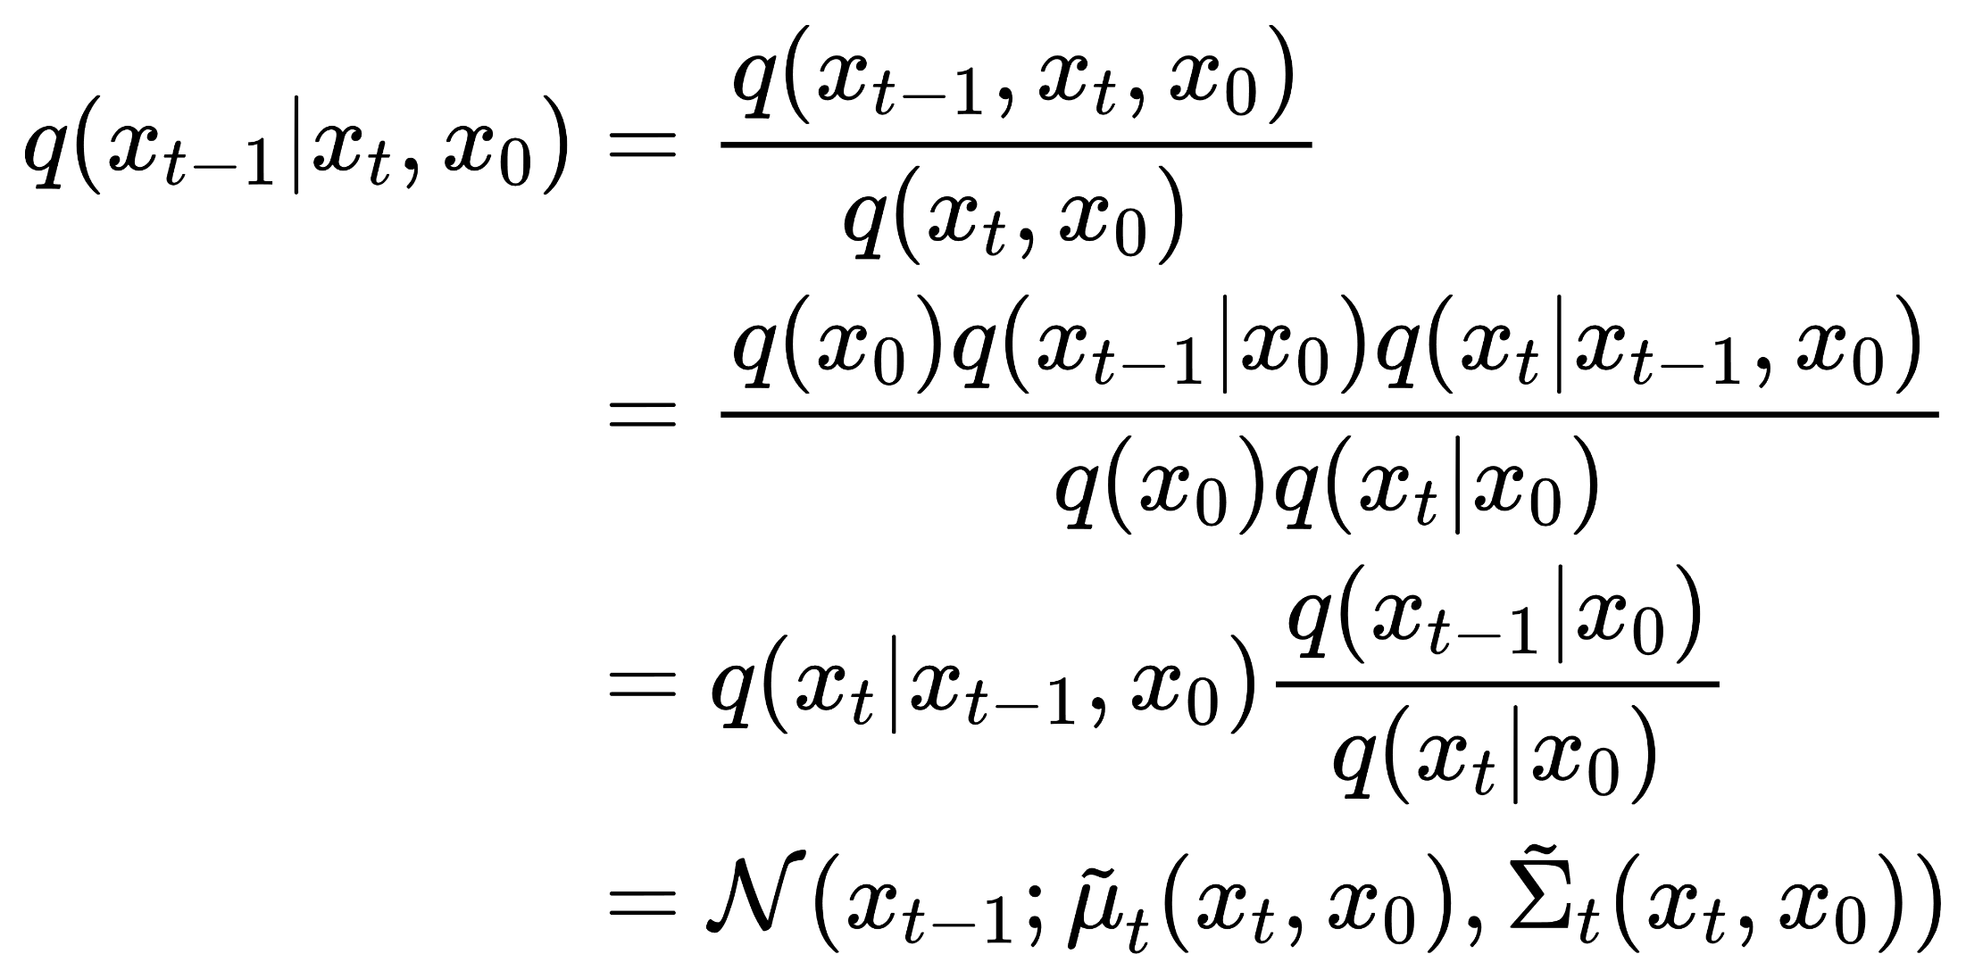
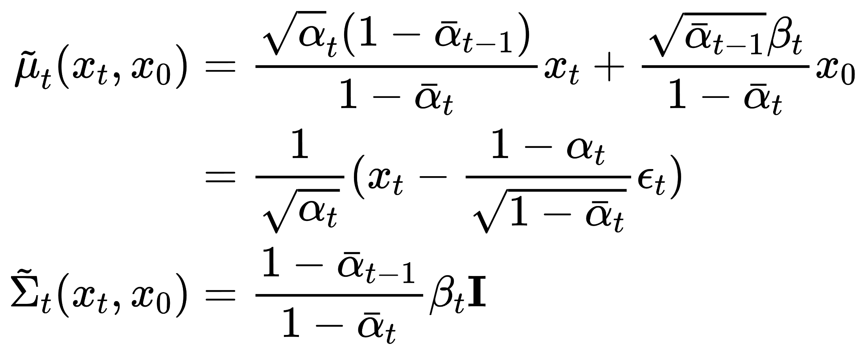
Denoising Process
Bayes' rule
Fitting
Fitter:

Slide 7
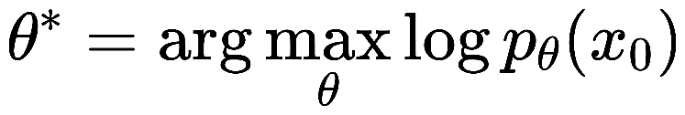
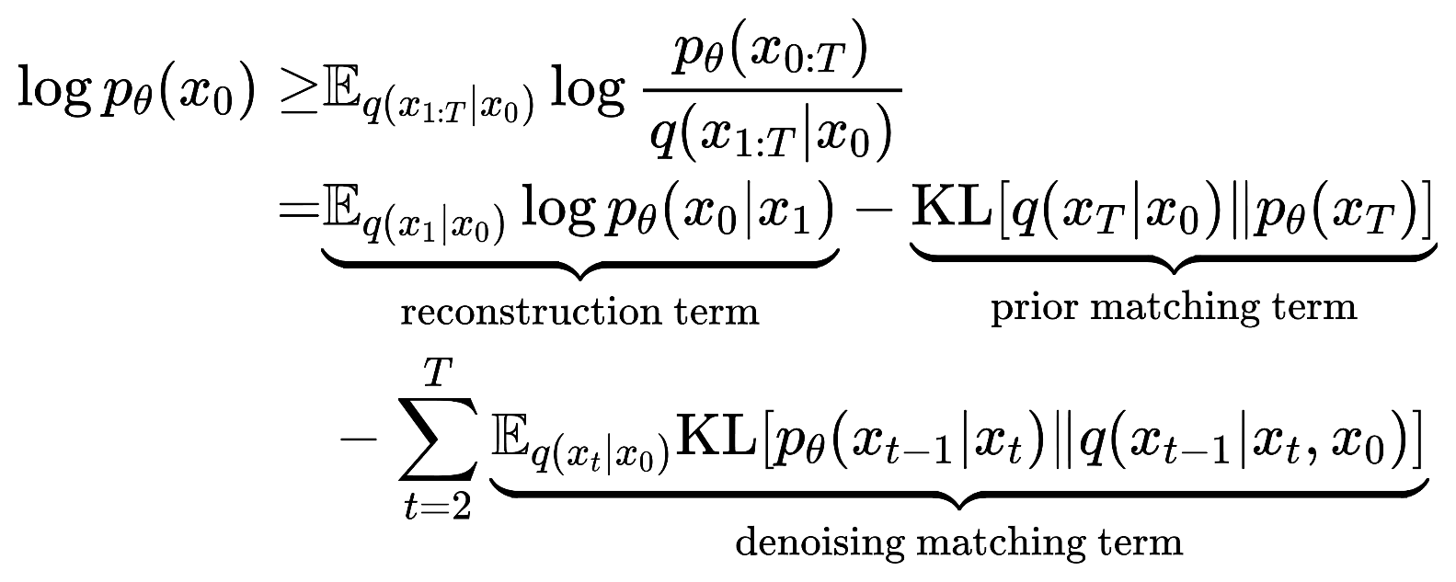
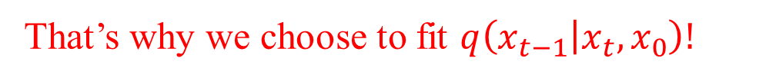
Maximum Likelihood
Target
Variational Inference
That’s why we choose to fit $q\left(x_{t−1} | x_{t},x_{0}\right)!$

Slide 8
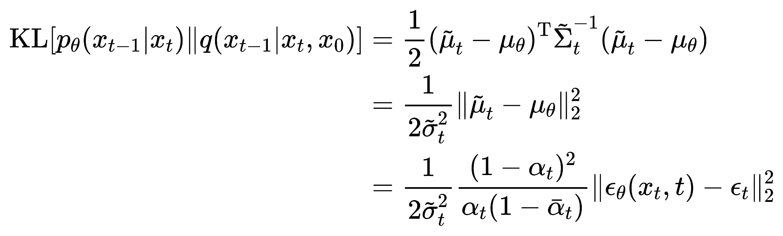
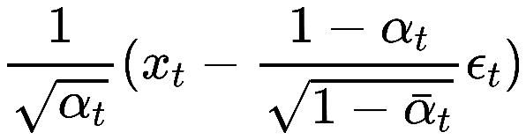
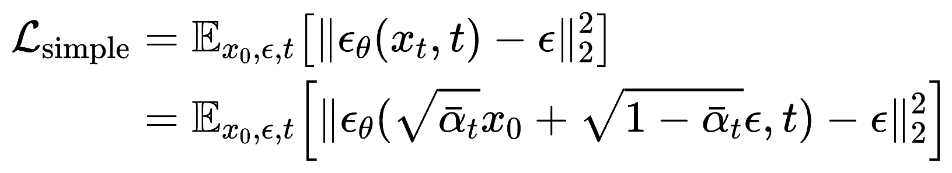
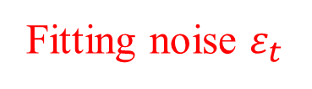
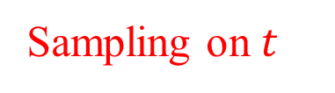
Loss Function
Denoising matching term
Fitting noise $ε_{t}$
Loss Function
Omit coefficients
Sampling on $t$

Slide 9
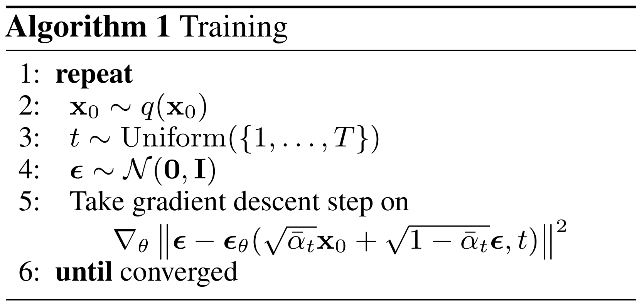
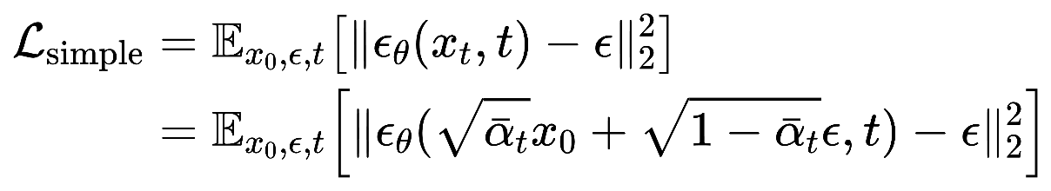
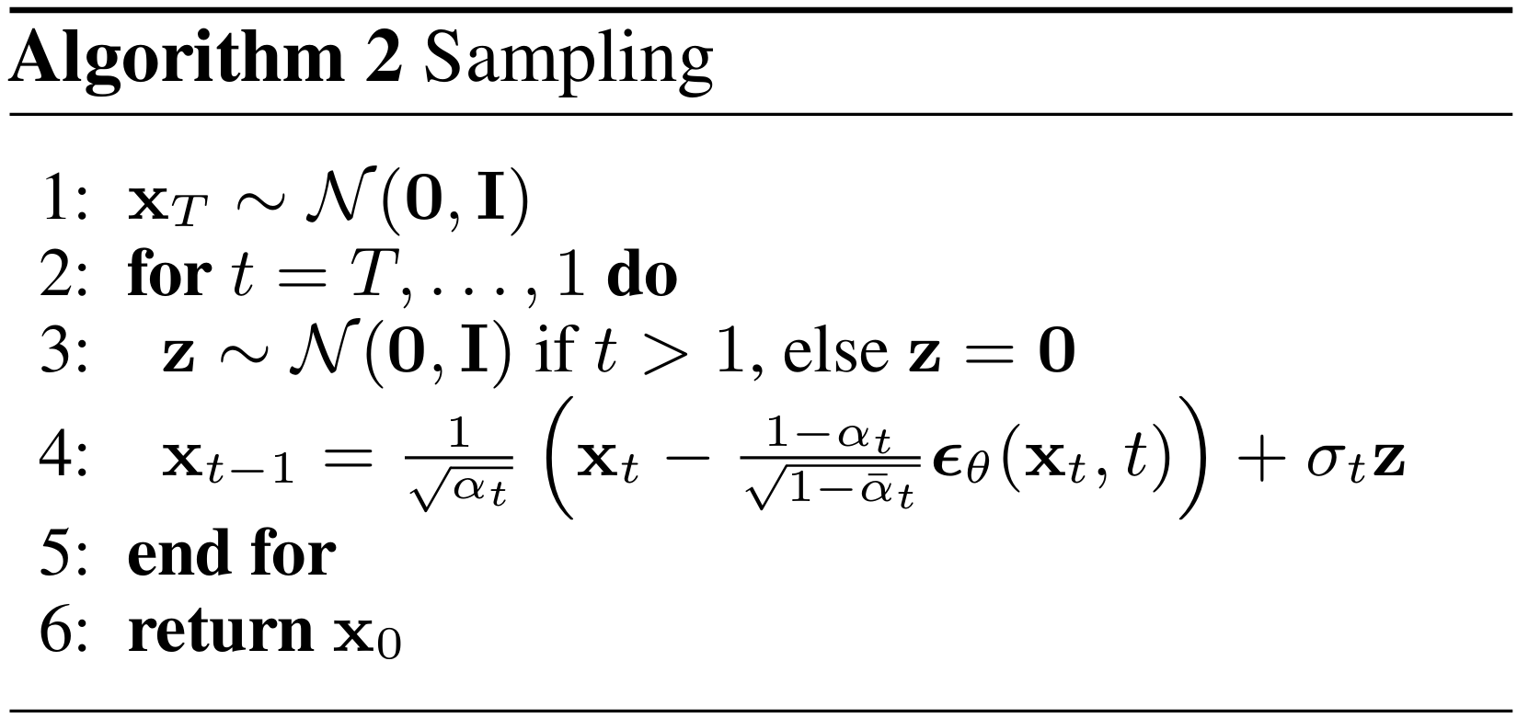
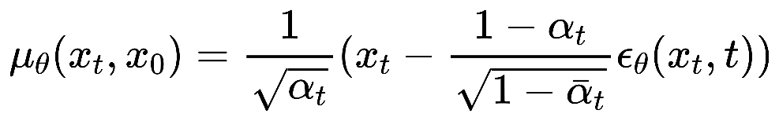
Training & Sampling

Slide 10
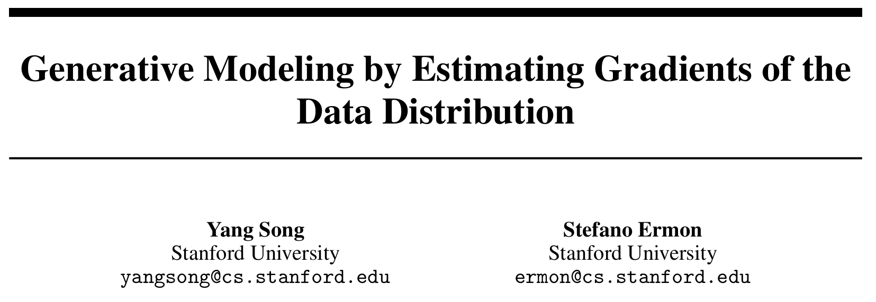
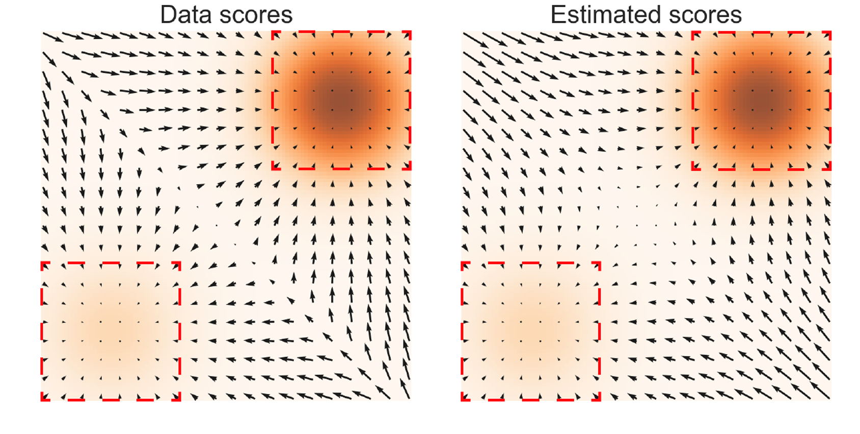
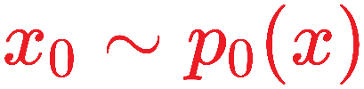
Score Matching
Fitting
Langevin Dynamics Sampling

Slide 11
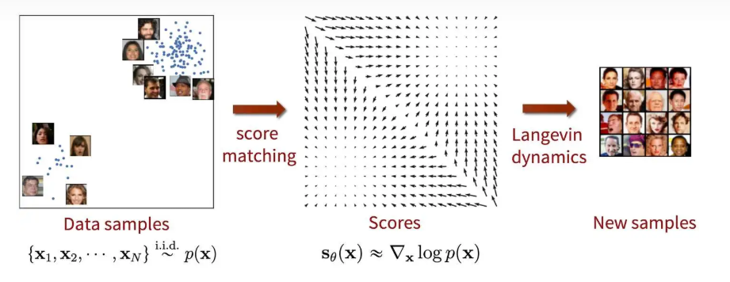
Score Matching

Slide 12
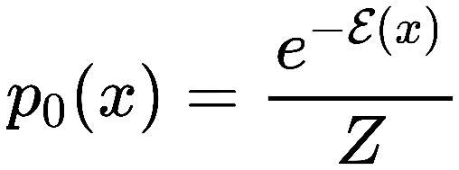
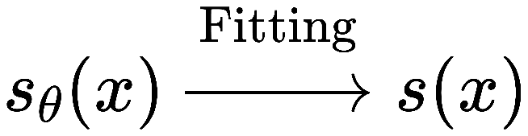
Score Matching
Target Distribution(Energy Model)
Energy term
Normalization factor Intractable!!!
Score Function
Note: The score function has a one-to-one correspondence with the energy-based probability distribution!!!
Fitting Score Function
Once the score function is fitted, how can we sample from the target probability distribution?

Slide 13
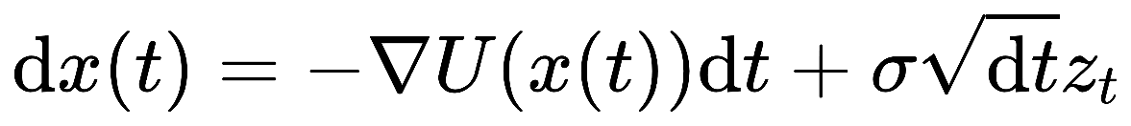
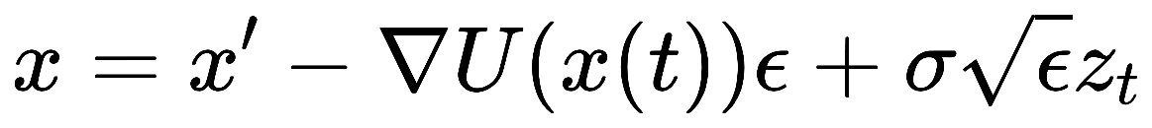
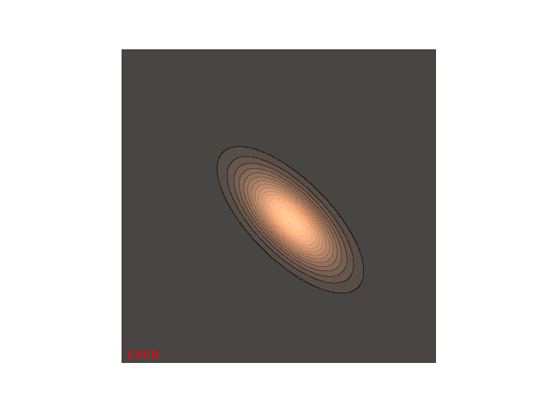
Langevin Dynamics
Langevin Equation
Discretization
Langevin Sampling
Potential
Langevin sampling drives particles towards the lowest energy region and induces random walks around it

Slide 14
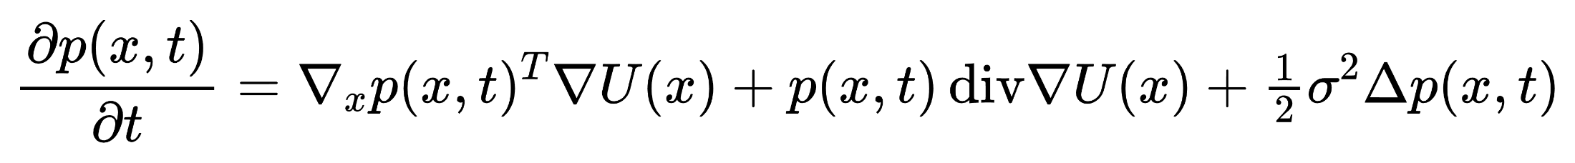
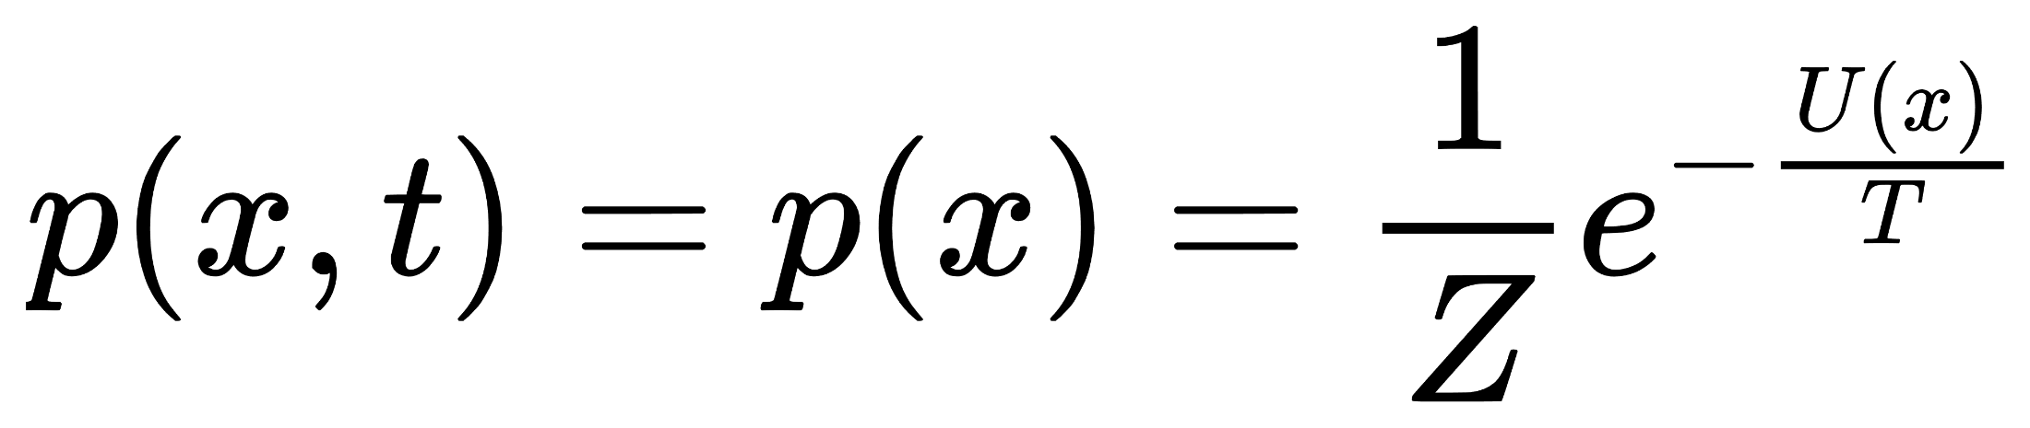
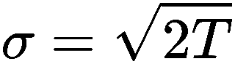
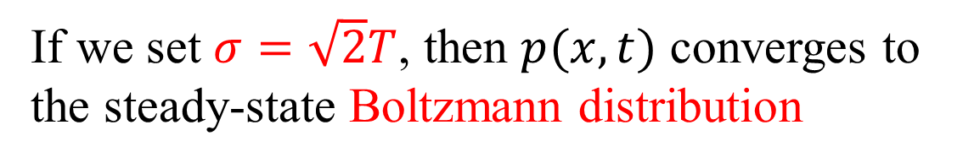
Steady-state Distribution
Fokker-Planck Equation
Evolution of PDF
PDF of LDS
Substitute
Steady-state Boltzmann Distribution
=>
Max-entropy
Distribution
If we set $σ=\sqrt{2}T$, then $p(x,t)$ converges to the steady-state Boltzmann distribution

Slide 15
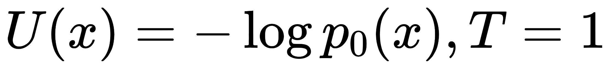
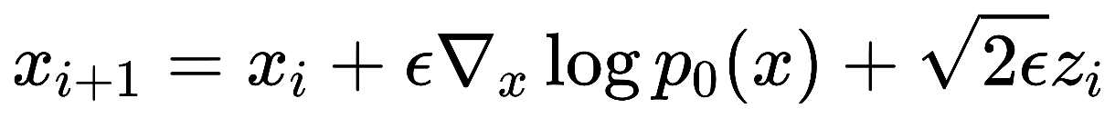
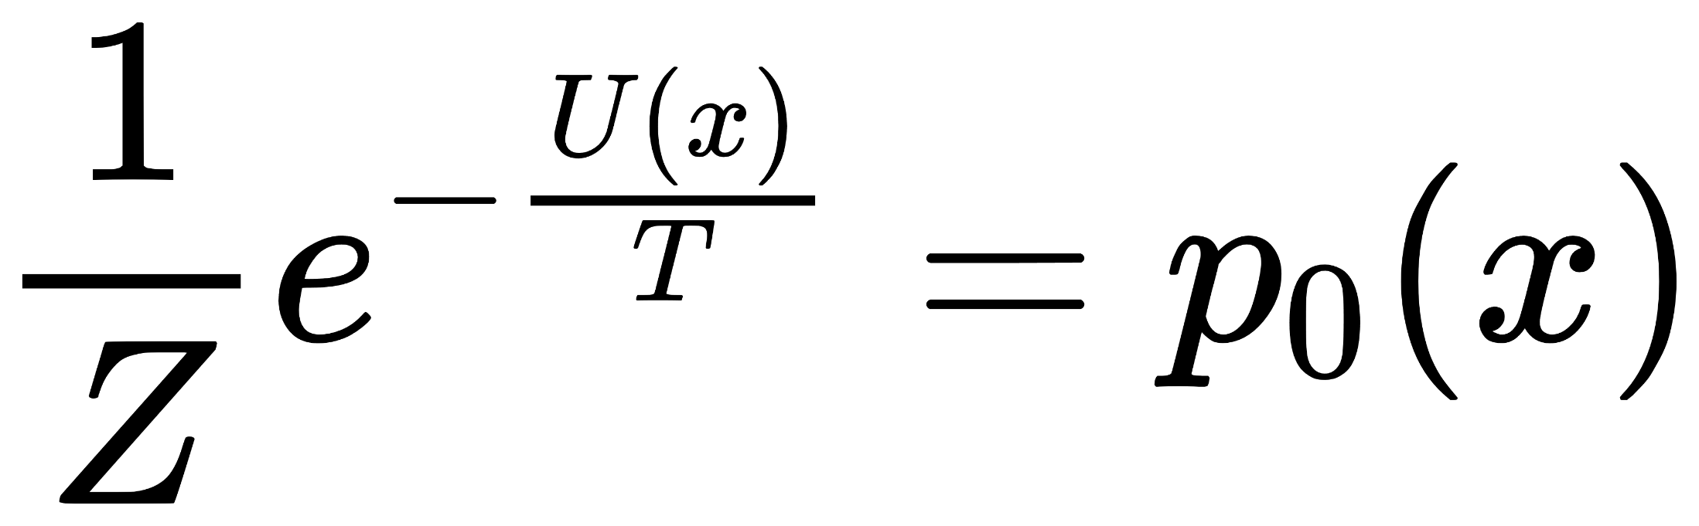
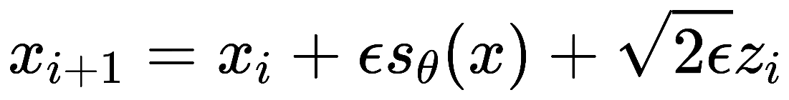
Langevin Sampling
Let
Langevin Sampling
Score Function
Steady-state Boltzmann Distribution
Inference
Langevin Dynamics Sampling

Slide 16
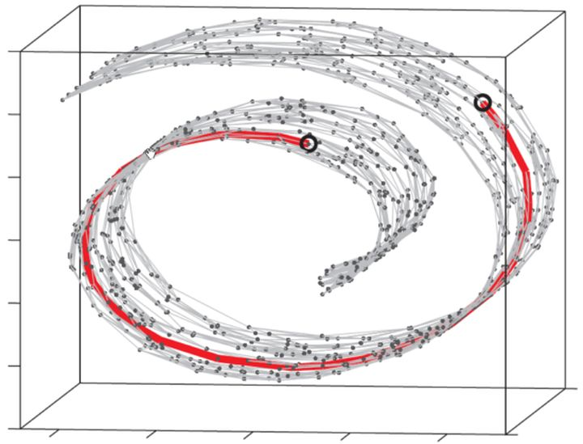
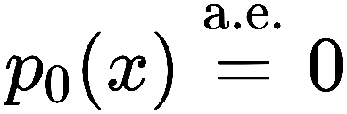
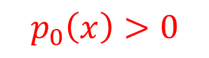
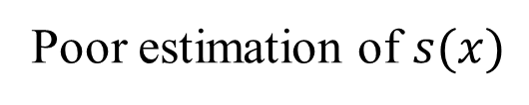
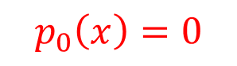
Degenerate Distribution
Image Space
$$p_{0}\left(x\right)=0$$
$$p_{0}\left(x\right)>0$$
Data Mainfold
The data manifold is a low-dimensional sub-manifold of the image space.
Poor estimation of $s(x)$

Slide 17
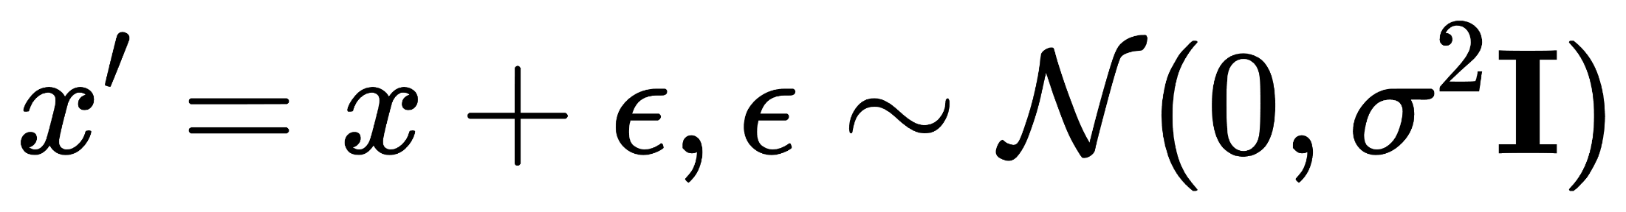
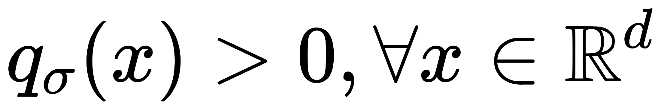
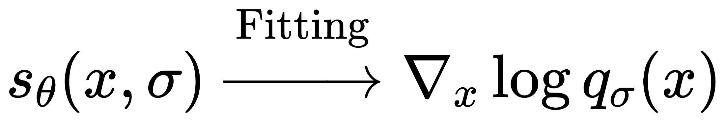
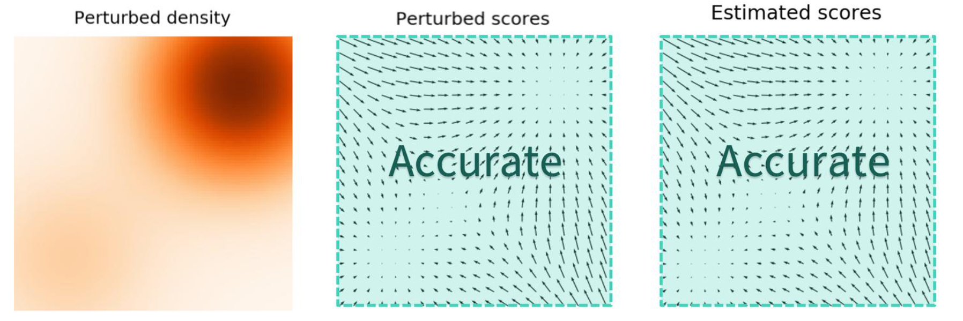
Noise Conditional Score Matching
Add Gaussian Noise
Corresponding PDF

Slide 18
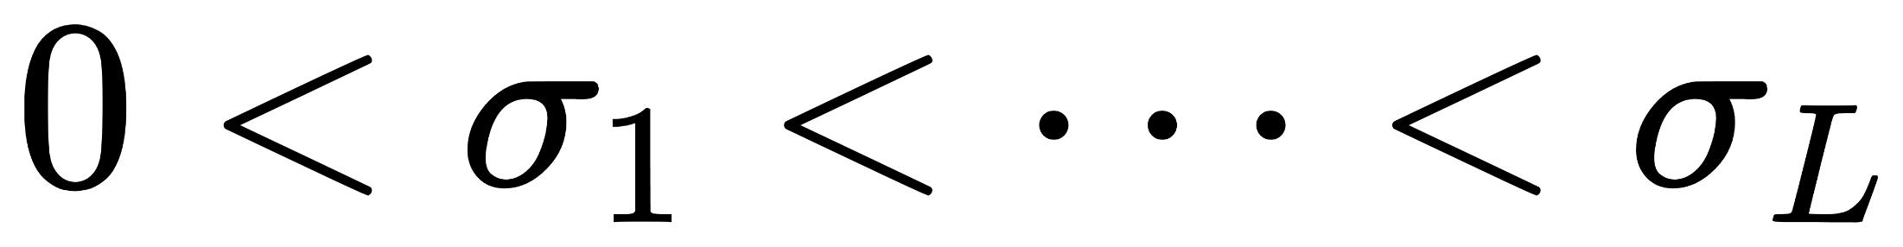
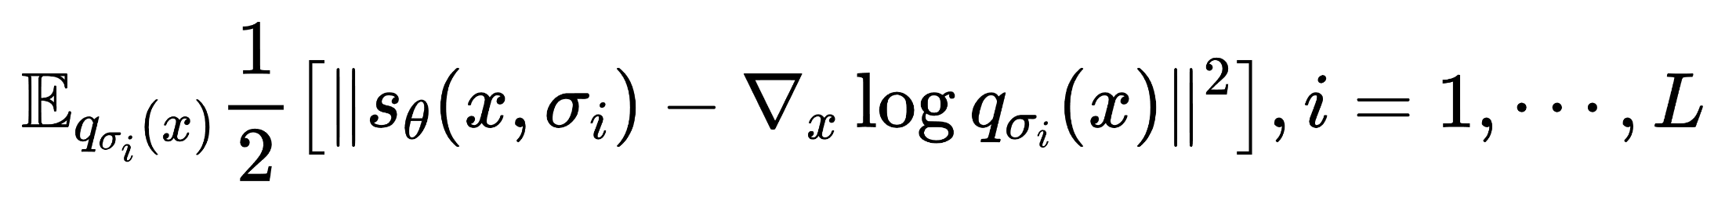

Noise Conditional Score Matching
Multi-scale Gaussian Noise
Corresponding Loss Function
Intractable!!!
Convert

Slide 19




Noise Conditional Score Matching
Over-all Loss Function
Experiments found that
=>

Slide 20





Annealed Langevin Dynamics
SMLD
……
……
$$σ_{k}$$
$$σ_{0}$$
$$σ_{L}$$
Blurred vision
Large step size
Clear vision
Small step size

Slide 21



Review DDPM
DDPM sets the number of Langevin sampling steps for each noise to 1
……
Therefore, DDPM requires setting a larger number of sampling steps

Slide 22




Applications
Conditional Generation
Classfier Guidance
Bayes
Classfier-free Guidance
$ω=0:$Fully unconditional generation
Diversity
$ω=1:$Fully conditional generation
$ω>1:$Fully conditional generation and stay away from unconditional generation

Slide 23





Applications
Energy-guided Generation
Customized Energy
Intermediate Energy Guidance
Marginal Distribution of $p_{t0}$
Score Function
=>
Posterior Sampling
Jensen

Slide 24


Acceleration Methods

Slide 25




SDE
Langevin Equation
Ito Process
Generalization
Continuous Form of Diffusion Process
SDE Form of Diffusion Process
Inverse Process
Noisy distribution
Score Function, Unknown
Noise Conditional Score Matching

Slide 26






ODE
SDE Form of Inverse Process
Fitting Noise ⬄ Fitting Score
ODE Form of Inverse Process
Variation of constants
Make a substitution
Taylor Expansion

Slide 27


DPM-Solver
Zeroth-order Approximation
DDIM!!!
First-order Approximation, Runge-Kutta
Approximate the first-order derivative using two forward steps
Second-order Approximation, Runge-Kutta
https://arxiv.org/abs/2206.00927

Slide 28






DPM-Solver++
Estimate image $x_{0}$by $x_{θ}$
=>
Make a substitution
Variation of constants
Taylor expansion, Runge-Kutta, similar to DPM-Solver
https://arxiv.org/abs/2211.01095

Slide 29


Experiments
DPM-Solver
DPM-Solver++

Slide 30
Classic Paper
Acceleration Methods
https://arxiv.org/abs/2010.02502, DDIM
https://arxiv.org/abs/2303.01469, Consistency Model
High-Resolution/Multi-modality
https://arxiv.org/abs/2105.05233, Classfier Guidance
https://arxiv.org/abs/2112.10741, Text2Image
https://arxiv.org/abs/2112.10752, Stable Diffusion
https://arxiv.org/abs/2212.09748, DiT
………….

Slide 31
Thank you for listening!

